Slide 1



Day 07
contact@anubhavtrainings.com
ABAP RESTFUL APPLICATION PROGRAMMING

Slide 2

Agenda – Day 07
Deploy Fiori App to S/4HANA On-premise using VS Code
What’s new in Fiori Launchpad for S/4HANA On-premise
Create Launchpad content in S/4HANA
Manage App in Launchpad spaces and pages
What is git and git HUB
Working with git
ABAP git scenario
Working with Analytic List Page
Working with OVP Application
Cross App navigation from OVP

Slide 3
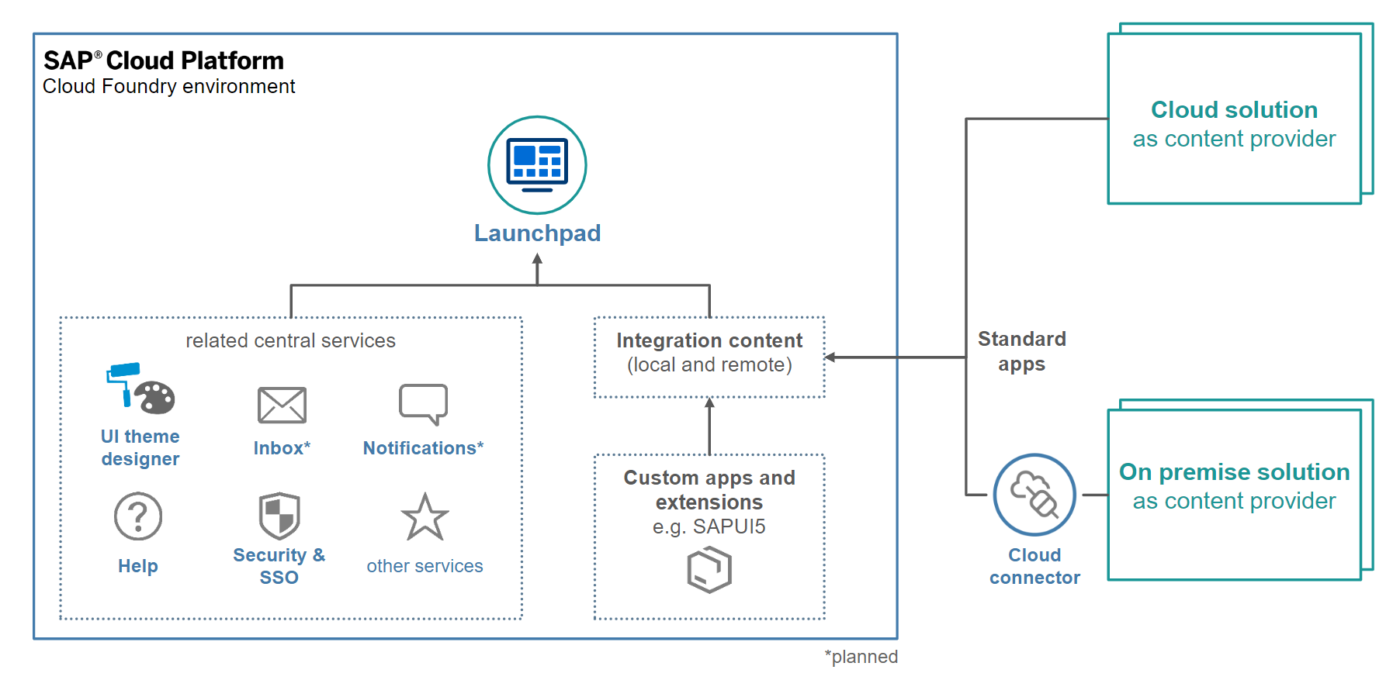
Fiori App with Launchpad and BTP
SAP BTP Platform Launchpad service is a new service on SAP Cloud Platform (Cloud Foundry) which is primarily focused on the enabling customers achieve a central Fiori Launchpad.

Slide 4

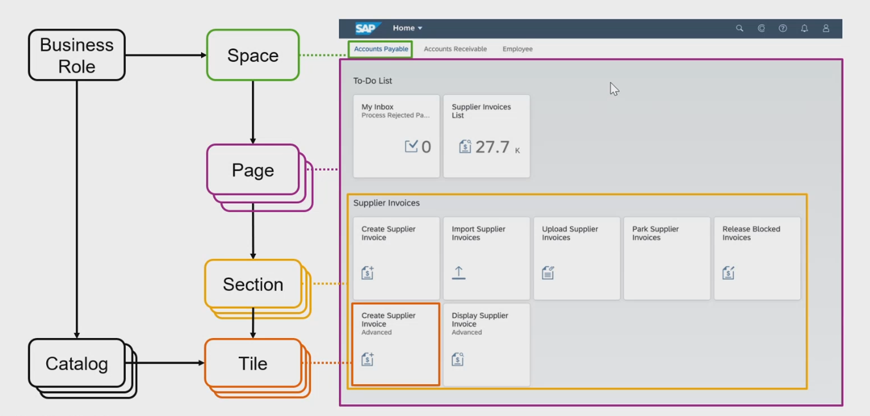
New Launchpad Structure
www.anubhavtrainings.com

Slide 5
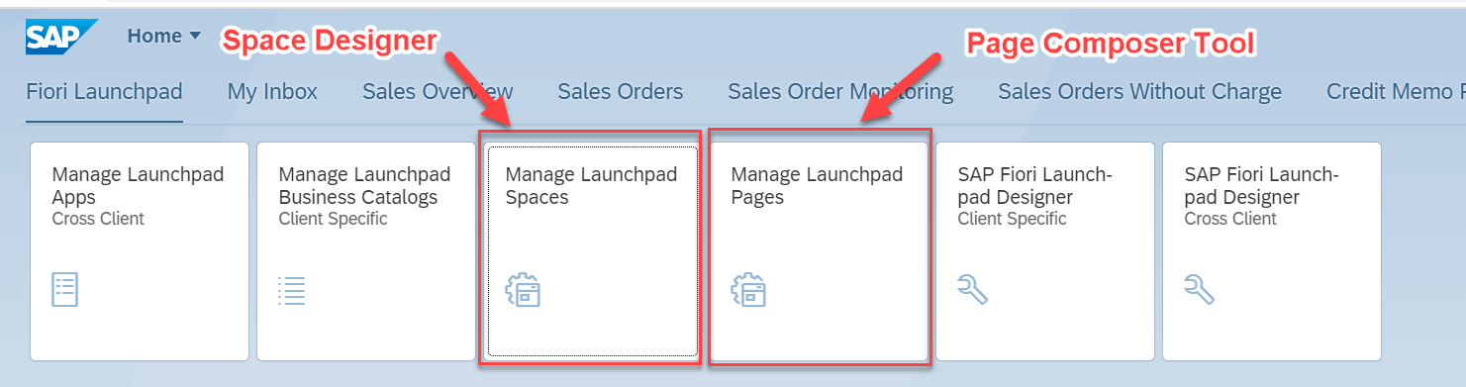
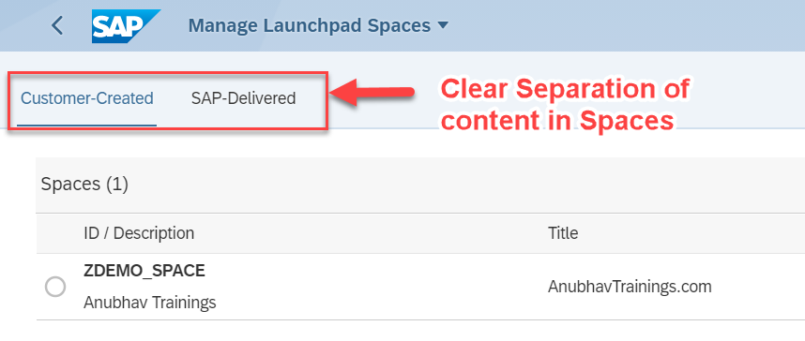
The new Tiles with S/4HANA 2020 – SAP_FLP_ADMIN
www.anubhavtrainings.com

Slide 6
S/4HANA2020- LPD is deprecated
Page composer and Space Designer
SAP_FLP_ADMIN
Fiori Launchpad
Maintenance of groups
SAP Fiori Launchpad
Designer
/n/UI2/FLPD_CONF
Maintenance of Business Catalog
FLP Content Manager
/UI2/FLPCM_CONF
/UI2/FLPCM_CUST
Maintenance of Technical Catalog
Tiles and Target Mappings
Fiori App Manager (earlier named as mass maintenance tool)
/n/UI2/FLPAM
www.anubhavtrainings.com

Slide 7

What is Git ?
Git is a free and open source distributed version control system designed to handle everything from small to very large projects with speed and efficiency.
Git is easy to learn and has a tiny footprint with lightning fast performance. It outclasses SCM tools like Subversion, CVS, Perforce, and ClearCase with features like cheap local branching, convenient staging areas, and multiple workflows.

Slide 8


Git and Git HUB
The git is a distributed repository management system and git hub is a repository which stores our code online.
Install git in our system from here check via command git --help
Mike
(Fiori Developer)
Julie
(Fiori Developer)
VS Code
BAS
git clone <REPO>
project
project
git init
git add . / git add <filename>
git commit –m <change text>
git push
git add . / git add <filename>
git commit –m <change text>
git push
02f35e2
Local git repository
Local git repository
GitHUB
REMOTE Repository
project
ab43f94
project
branch
master
git reset <commitid>

Slide 9
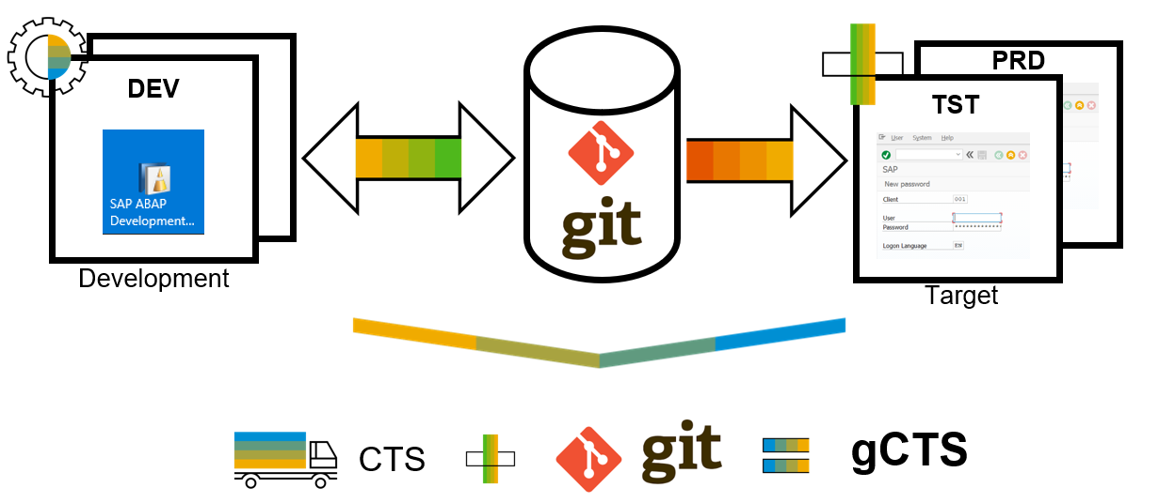
What is ABAP Git ?
abapGit is a tool to import and export code between ABAP systems. If a developer has a developer key to the system, the developer can perform these actions already. abapGit enables the developer to do mass export/changes/imports but not more than already possible to do manually.
Running automated security checks on the abapGit code will by design give a lot of errors, as abapGit will import, overwrite and change ABAP artifacts in the system in ways that might not be intended. Always review all code in remote repositories before importing to the target system, this is possible because abapGit is plain text unlike traditional transport files.
That being said, abapGit is used by mutiple organizations, all abapGit changes are reviewed via pull requests. And all 100+ repository watchers are automatically notified for every change to the code base, so potentially all changes are looked at by more people than tradtional enterprise products.

Slide 10
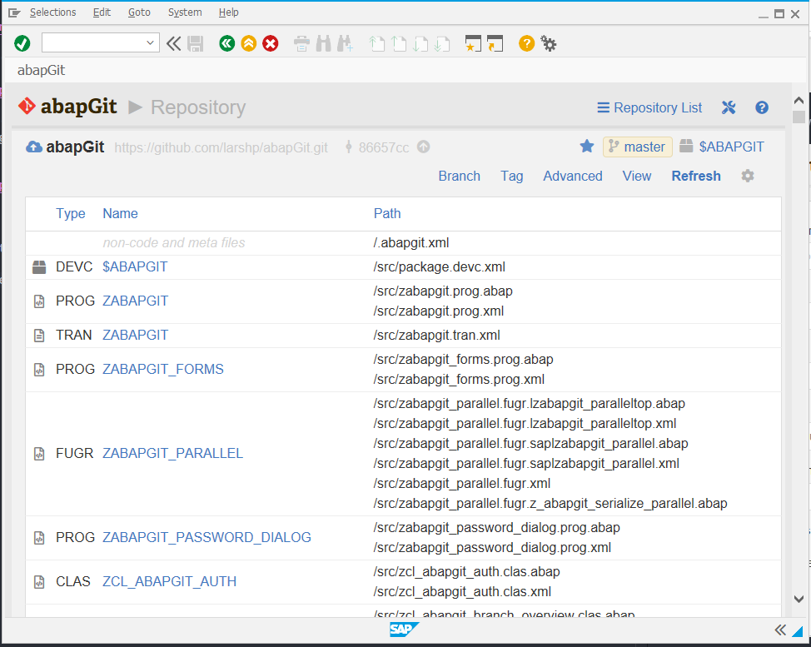
ABAP Git
It is a community effort to support the project, recommend watching the project to get a feeling about issue resolution. Everyone can suggest changes to abapGit via pull requests.

Slide 11
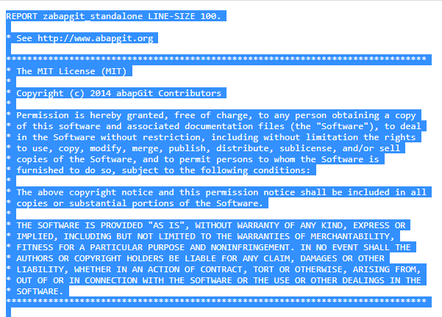
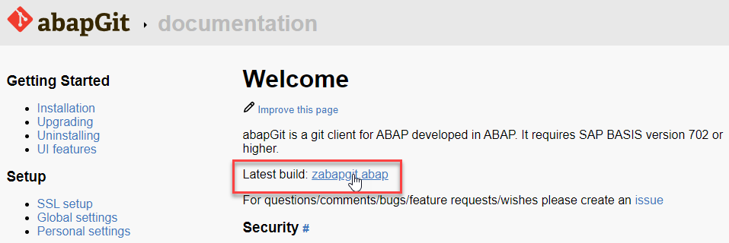
ABAP Git Integration
Step 1. Go to https://docs.abapgit.org/ in browser and click on Latest Build.
Step 2. Copy this Code.

Slide 12
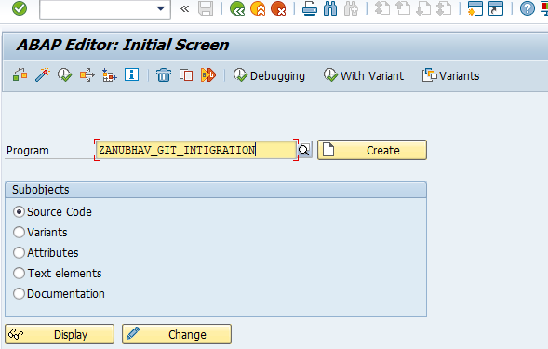
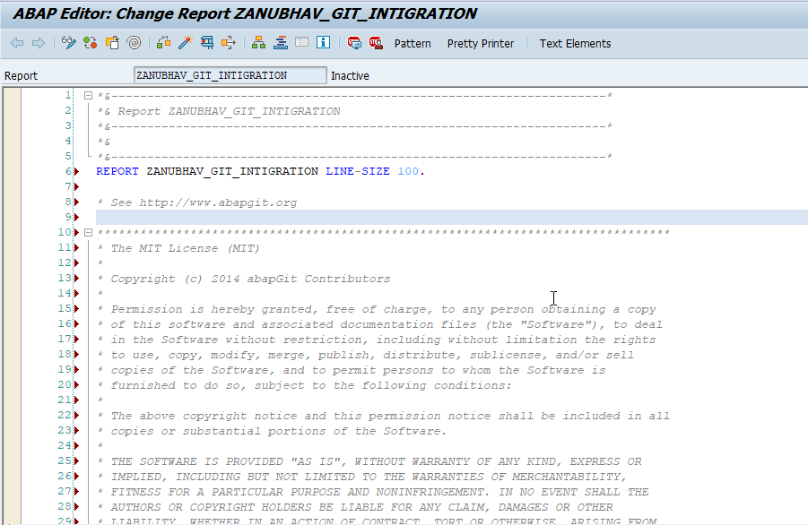
ABAP Git Integration
Step 3. Open SAP Gui Go to T-Code SE38 for Building Report, give any name to report and click on create.
Step 4. Paste the Copied Copy in this report.

Slide 13
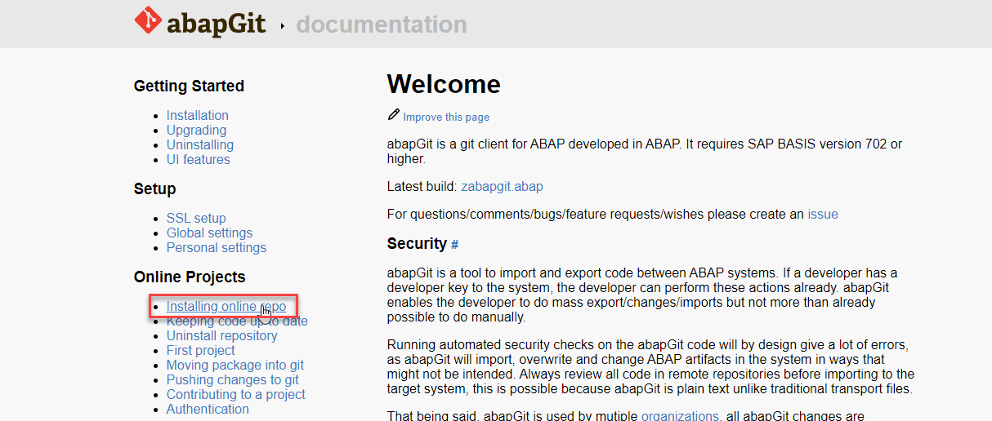
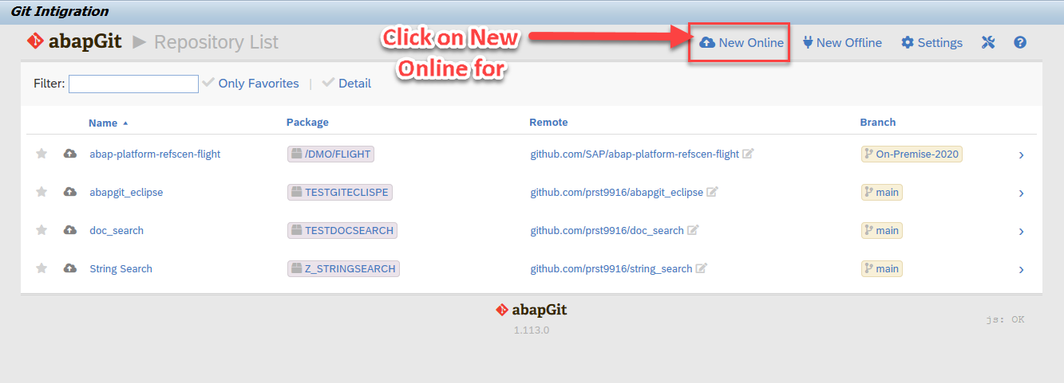
ABAP Git Integration
Step 5. After the Execution, abapGit Screen
Step 6. Go back to Bowser side and click on Installing Online Repo

Slide 14
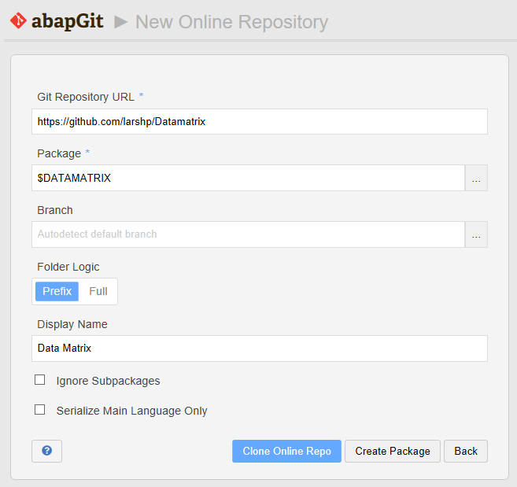
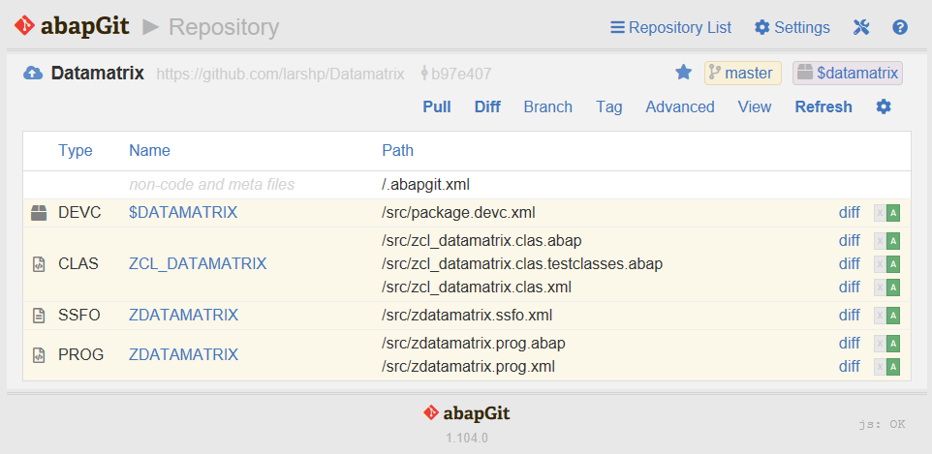
ABAP Git Integration
Step 7. Enter the url for the Github project, eg https://github.com/larshp/Datamatrix along with a package name, eg. $DATAMATRIX. If the package does not exist yet, it will be created automatically when pulling. Alternatively, you can select “Create Package” to create the package manually with your own settings.
Step 8.Select “Clone Online Repo”
Select “Pull” to copy all objects from the Git repository into the SAP system

Slide 15

End of Day 07
Trainer: Anubhav Oberoy

Slide 16
Trainer: Anubhav Oberoy

Slide 17
THANK YOU
If you cannot do
great things, do small things in a great way.
Anubhav Oberoy
https://www.anubhavtrainings.com

Slide 18


We’re committed to empower you to be
Most Desirable Resource
through powerful training solutions.
We build the workforce of the future.
250+
Corporate Clients
30,000+
Learners Trained
25000+
Learners Placed
FREE WEBINARS
Sign up for free webinars with industry experts every fortnight!
Enroll Now!
Contact us today!
https://anubhavtrainings.com/

Slide 19




More from AnubhavTrainings.com

